Slide 1
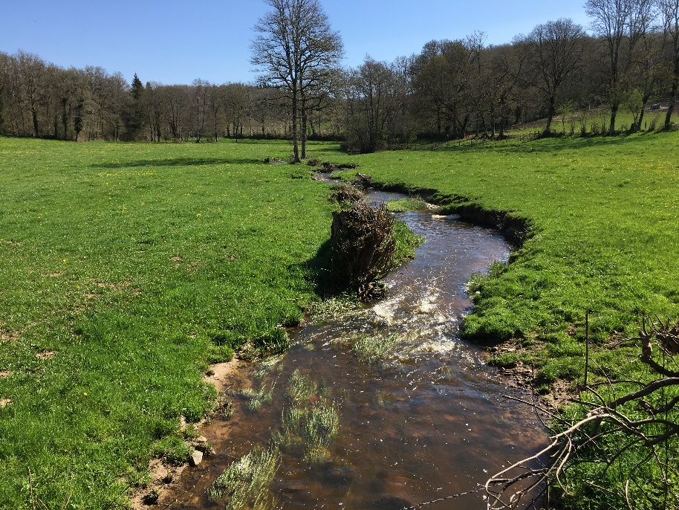
Evaluation of the Impact of the CAP on Water
Project manager: Alice Devot (Oréade-Brèche)
Evaluation team: Charlotte Daydé, Lyvia Manzato, Adrien de Pierrepont, Célie Bresson, Damien Lisbona, Juliette Augier, Laurence Menet (Oréade-Brèche) - Matthew O’Hare (CEH)
The information and views set out in this evaluation are those of the author(s) and do not necessarily reflect the official opinion of the Commission

Slide 2
Water status and pressures in the EU
Water issues and Agriculture
In a context of climate change and a fast-growing population, sustainable water management represents a major issue, to protect water resources and secure their supply in terms of quantity and quality
Agricultural diffuse pollution significantly affects the chemical status and ecological status of waterbodies in the EU - main pollutants from agriculture include nutrients, pesticides, sediment (from soil erosion) and faecal microbes
Agriculture is a significant source of water abstraction for irrigation and affects the hydromorphology of surface waterbodies (modification of the stream flow, physical modification of meanders)
The Water Framework Directive (WFD)
Surface water and groundwater bodies must achieve good chemical, ecological and quantitative status by 2027
Member States are required to identify the waterbodies’ status and define River Basin Management Plans to address water issues and improve the status of waterbodies
Source: Wise-SoW database including data from 24 Member States (EU-28 except Greece, Ireland, Lithuania and Slovenia)
Share of surface waterbodies failing to achieve good ecological status

Slide 3
Agricultural practices affecting water
Adverse effects of agriculture on water status depend on the management systems implemented by farm and forest holders
Agricultural practices having an impact on water quality and quantity are associated with:
Land occupation
Crop/plot management
Livestock management
Use of specific equipment
Forest, nitrogen-fixing crops, permanent grasslands, landscape features, crop diversification, etc.
Soil incorporation of crop residuals, use of biological control of pests, non-ploughing of slopes, reduced tillage, etc.
Prevention of livestock overgrazing, no trampling along watercourses, adequate storage of manure
Equipment for water collection and re-use, use of precision farming equipment for fertilisers and pesticides or irrigation

Slide 4
Scope and objectives of the evaluation
The evaluation examined where and in which ways the CAP instruments and measures influence water quality and water quantity. It covers the programming period 2014-2020
Much of the analysis focused on the contribution of the CAP measures addressing sustainable management of natural resources and climate actions
Pillar I
Reg. (EU) No 1307/2013
Direct payments (BPS, VCS, Greening payments, etc.)
Reg. (EU) No 1308/2013
Sector-specific market support measures
Pillar II
Reg. (EU) No 1305/2013
Rural Development Measures
Knowledge transfer and cooperation
M1 Knowledge transfer and information actions
M2 Advisory services, farm management and farm relief services
Land management and sustainable management practices
Territorial development (including investment in non-agricultural activities)
M19 LEADER
M16 Cooperation
M10 Agri-environment-climate
M11 Organic Farming
M12 Natura 2000 and Water Framework Directive payments
M13 Payments for areas facing natural constraints
M15 Forest-environmental and climate services and forest conservation
M4 Investment in physical assets
M8 Investment in forest area development and improvement of the viability of forests
Horizontal Measures
(GAEC, SMR, Farm Advisory System, etc.)
Cross-Compliance instruments considered
GAEC 1 Buffer strips along water courses
GAEC 2 Authorisation for abstraction
GAEC 3 Groundwater protection
GAEC 4 Minimum soil cover
GAEC 5 Land management to limit erosion
GAEC 6 Maintenance of soil organic matter
GAEC 7 Retention of landscape features
SMR 1 Against water pollution by nitrates
SMR 10 Placing of Plant Protection Products on the market

Slide 5
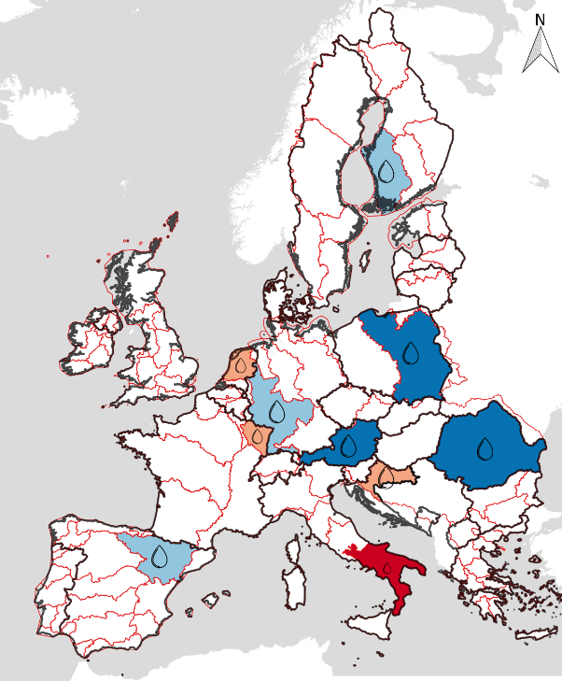
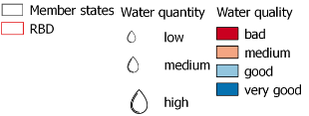
Methodology and data
Case-study River Basin Districts
Case studies in River Basin Districts located in 10 Member States: DE, ES, FR, HR, IT, NL, AT, PL, RO, FI
Interviews at the local and national level
Survey to 120 farm advisers in the RBD studied
Statistical data from CATS, Eurostat (AEI and LUCAS), FSS, WISE
Implementation data of the RDP (planned and executed budget 2014-2020 for EU-28) – Annual Implementation reports and CMEF indicators
FADN analysis of the CAP support and agricultural practices implemented by the beneficiaries
Source: Alliance Environnement

Slide 6
Methods, tools and data sources used for each ESQ
 |  | EU and/or Member States/regions monitoring and reporting data analysis | Statistical, indicators and other data analysis (e.g. trend, cluster analysis) | FADN data analysis | Analysis of official documents (e.g. EU legislation, Member States/regions’ Programmes) | Literature review | Case study interviews and other information | Semi quantitative matrix scoring | Evidence-based expert judgement and qualitative analysis | Results from previous ESQs
Causal analysis | ESQ 1 | $$√$$ | $$√$$ |  | $$√$$ | $$√$$
 | ESQ 2 |  |  |  |  | $$√$$ | $$√$$
 | ESQ 3 |  | $$√$$ | $$√$$ |  | $$√$$ |  |  |  | $$√$$
Effectiveness | ESQ 4 |  | $$√$$ |  |  | $$√$$ | $$√$$ |  | $$√$$ | $$√$$
 | ESQ 5 | $$√$$ | $$√$$ |  |  | $$√$$ | $$√$$ |  | $$√$$ | $$√$$
 | ESQ 6 |  |  |  | $$√$$ | $$√$$ | $$√$$ |  | $$√$$
 | ESQ 7 |  |  |  | $$√$$ | $$√$$ | $$√$$ | $$√$$ | $$√$$
 | ESQ 8 |  |  |  |  | $$√$$ | $$√$$ |  | $$√$$ | $$√$$
Efficiency | ESQ 9 |  |  | $$√$$ |  | $$√$$ | $$√$$ |  |  | $$√$$
 | ESQ 10 |  |  |  |  | $$√$$ | $$√$$ |  | $$√$$
Coherence | ESQ 11 |  |  |  | $$√$$ |  | $$√$$ | $$√$$
 | ESQ 12 |  |  |  | $$√$$ |  | $$√$$ | $$√$$
 | ESQ 13 |  |  |  | $$√$$ |  | $$√$$ | $$√$$
Relevance | ESQ 14 |  |  |  | $$√$$ |  | $$√$$ | $$√$$
EU added value | ESQ 15 |  |  |  |  | $$√$$ | $$√$$ |  | $$√$$ | $$√$$

Slide 7
General limitations to the evaluation
RDP Output data aggregated under Priority 4
Variety of context, water issues and implementation choices across EU
No WISE data available to assess the number of waterbodies failing to achieve good status because of agricultural pressures
Many instruments and tools already existing before 2014
Latency period before observing effects on water
Not possible to record budget and operations engaged under FA 4B ‘improving water sustainable management’
No clear trend in the results observed
Impossibility of quantifying the results achieved
No before/after comparison
Estimation of the potential effects

Slide 8
Main conclusions on …
Implementation choices and drivers
Relevance and EU added value
Coherence of the CAP measures
Technical and social innovations
Effectiveness of CAP instruments and measures on water
Efficiency of the CAP instruments and measures

Slide 9
Implementation choices and drivers
Member States allocated substantial budget to environmental measures…
Pillar I: 23.3 billion EUR spent on the Greening measures over 2015-2017
Pillar II: 80.0 billion EUR planned on P4/5A/5D/5E, mainly on:
M10 AECM
M13 Payments to ANCs
M11 Organic Farming
M4 Investments in physical assets
M8 Forest investments
… but did not sufficiently target water issues
Pillar I: Greening requirements were not ambitious enough to improve farmers’ practices:
Large choice in the EFA eligible – not all EFA play a significant role in water protection
Equivalent practices to crop diversification measure for maize growers (FR, PT)
The share of permanent grassland as ESPG varies among MS
Pillar II: Eligibility/selection criteria not sufficiently used to target operations relevant for water protection and/or beneficiaries in areas with water issues
Ex. Eligibility criterion set to support projects favouring improvement and design of drinking water protection forests (M8 in AT) or selection criteria (projects located in NVZ/ flood risk areas)

Slide 10
Implementation choices and drivers
Cross-compliance implementation could be more stringent
Cross-compliance is not implemented by Member States in a way that really protects waterbodies from fertilisers, pesticides and sediment pollution
SMR 1 has been implemented in a way that effectively protects water from nutrient pollution. However, it only applies in Nitrate Vulnerable Zones. Member States’ decisions regarding the delineation of NVZ is thus determinant.
The implementation choices of other CAP instruments and measures can indirectly affect water status
BPS | Redistributive payments and convergence influence the distribution of BPS/SAPS. From a water perspective, high BPS/SAPS is particularly needed to ensure the economic viability of holdings implementing less profitable practices beneficial for water
VCS | VCS to support the livestock and protein sectors with positive contribution to water protection to maintain grasslands and increase the nitrogen-fixing crop areas Only few MS implemented upper limits to VCS granted to livestock to avoid intensification and increased pressures on water
CMO | Support is granted to F&V and wine producers for investments in efficient irrigation systems (except in PL, FI). Potential savings are usually required. CMO support is very attractive for farmers in ES
M13 | FI, AT, HR and FR allocated high budget to M13 under P4, thus contributing to the maintenance of holdings in ANCs and avoiding the concentration of the agricultural production in suitable areas

Slide 11
Implementation choices and drivers
Avoidance
of disturbance
for farmers
Mandatory environmental requirements
(cross-compliance, greening measures)
Economic and historical factors
For the implementation of the CAP, Member States and Managing Authorities gave priority to:
Economic and historical factors
Need to enforce the mandatory environmental requirements under Cross-Compliance and the Greening Measures
Avoidance of technical and economic disturbance for farmers
There were varying levels of ambition among Member States as regards the environmental objectives
However, water issues were addressed in the RDP in all case-study Member States, notably through:
Involvement of water authorities in the design process of the RDP
Co-funding by water authorities of voluntary measures to help farmers implement beneficial practices for the protection of waterbodies
Concomitant elaboration of the RBMP (strategic information about the water issues and measures needed, stakeholders involved in the design process of both documents)
Involvement of water authorities
Concomitant elaboration of the RBMP
Water issues addressed in the RDP
Co-funding by water authorities

Slide 12
Implementation choices and drivers
Implementation choices and drivers
According to the farm advisers surveyed, the main drivers leading the farmers to implement the Greening measures, M 4 Investments support, M10 AECM, M11 Organic Farming in case-study MS are:
1st driver: Economic reasons
2nd driver for M4 and Greening measures: Compliance with new standards
2nd driver for M10 AECM and M11 Organic farming: Environmental and climate motivations
Economical and geographical patterns also influence the implementation choices of farmers:
Farmers located in Areas with Natural Constraints are more inclined to subscribe to M10 and M11
M4 investment support was generally more used by farmers with high income and large UAA
M10 beneficiaries are mainly livestock breeders growing more than four crops and having large UAA.
The level of knowledge and awareness of farmers and the provision of adequate advisory services, are factors influencing the choices of farmers to implement measures addressing water issues.
It was pointed out during the interviews that water-related measures are less attractive for intensive farming systems, generally located in regions facing water problems (DE, FR and AT).

Slide 13
Effectiveness of CAP instruments and measures on water
The CAP framework was assessed as effective to maintain minimum practices beneficial for water quality
Effects of CAP instruments and measures on water quality
Instruments and measures effectively contributing to preventing an increase of the fertilisers/pesticides used and their transfer to watercourses:
Cross-Compliance (e.g. buffer strips, retention of landscape features)
Greening measures - EFA, Crop diversification and Permanent grassland
RDP measures: M10 AECM, M11 Organic farming and M4 investment support (to a lesser extent)
Instruments and measures contributing to preventing an increase in soil and bank erosion:
Cross-Compliance (winter cover of soil, retention of landscape features)
Greening measures (EFA, Permanent Grassland)
However, the uptake of relevant RDP measures varies among MS thereby limiting their positive contribution to water
Agricultural sectors with the highest expenses in fertilisers/pesticides (i.e. fruits, vegetables, wine, flowers)
are not subject to Greening measures
are only subject to Cross-Compliance when receiving sector-specific support under CMO

Slide 14
Effectiveness of CAP instruments and measures on water
The CAP framework had limited effects on water quantitative aspects
Effects of CAP instruments and measures on water quantity
Sectors with the largest irrigated areas over 2015-2016 are not constrained by the CAP framework (e.g. maize in France, fruits and vegetables):
French single-crop maize growers benefit from a certification scheme to replace the crop diversification requirement with a winter soil cover
Fruit and vegetable producers are not subject to Greening measures
GAEC 2, as implemented by Member States, doesn’t guarantee compliance with authorisation procedures for irrigation
The overall effect of RDP measures is also very limited: the percentage of irrigated land switching to more efficient irrigation systems was nearly nil at the EU level, although it reached 53% in Romania and 16% in Poland
No clear controls of the water savings achieved are carried out following an investment in irrigation systems with the support of the M4 measure

Slide 15
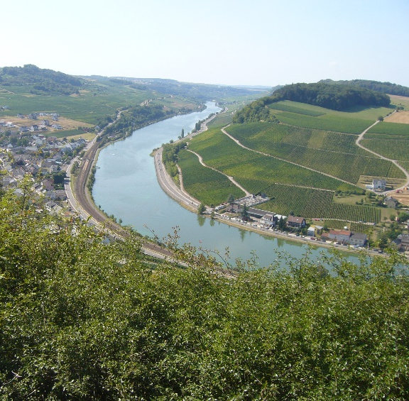
Effectiveness of CAP instruments and measures on water
Effectiveness of CAP instruments and measures on water
The effect of other CAP instruments and measures (DP, VCS, ANC) on water are difficult to assess
Effects of other CAP instruments and measures on water quality and quantity
Direct Payments
The income support appears to be essential for the profitability of many farm types
However the present area-based system is remunerating more large holdings independently of their environmental impact (or need for support)
Voluntary Coupled Support and M13
This support also contributes to the maintenance of specific types of farming beneficial for water (e.g. extensive livestock farming, protein crops)
The absence of such support could have led to a concentration of the agricultural production in favourable areas, with increased pressures on the waterbodies concerned
Effects of other factors influencing the effectiveness of the measures
Pedo-climatic conditions and climate change
Economic factors (pushing farmers to implement specific practices and crops)

Slide 16
Technical and social innovations
At the EU level, adoption rates are lower for social innovations compared to technological innovations
The adoption rate of innovations varies across the EU, e.g. the use of optimised soil management equipment is more developed in western and central EU; high-efficiency irrigation systems are more common in Mediterranean Member States.
The most widespread social innovations are collective management of the water resource in Spain, groups of farmers or mixed stakeholders working on local challenges in DE, FR, NL and AT and groups of farmers sharing equipment in IT, RO and FI.
Some innovations with significant potential for water management are still under-developed, e.g. reuse of waste water.
Various factors can favour or hinder the adoption of innovations, e.g. farm size and farmers’ capacity to invest, the Nitrates Directive, the governance structure and cultural context, regulation (e.g. on water reuse), societal factors (e.g. social innovation in ex-communist Member States), etc.
Farmers’ knowledge and awareness are of great importance to avoid the misuse of innovations and rebound effects on water quality and/or quantity.
Limitations Limited data availability to assess the uptake of innovations across the EU

Slide 17
Efficiency of the CAP instruments and measures
Greening measures and Cross-compliance
Greening measures and Cross-compliance entailed few opportunity costs, except for highly specialised farms: most farmers already comply with the standards provided by the legislation and the provisions implemented by the Member States
Direct costs of these schemes, i.e. the payments granted to the beneficiaries for their implementation, are assessed as low (when Greening Payments are considered as a share of Direct Payments, which is conditional upon compliance of farmers with environmental and climate obligations)
Rural Development Measures
M10 AECM - one of the most effective measures in reducing agricultural pressures on water
However, the average calculation of the payment rate of M10 often fails to cover the opportunity cost, especially for highly productive farms
Targeting AECM on relevant beneficiaries / geographical areas regarding water issues also improved its efficiency in some Member States
M11 Organic Farming - one of the most effective measures in reducing agricultural pressures on water
Member States with the highest payments/hectare are those with the largest supported areas (DE, IT, EL)
Higher payment rates are considered as efficient insofar as organic farming prevents water pollution from fertiliser and pesticide and its associated depollution costs
M15.1 Forest-environment and climate services and M8.1 Afforestation
Failed to cover the transaction costs associated with their implementation, however the opportunity costs were reasonably well covered
The level of adoption of M15.1 seems to be linked to the amount of support provided per hectare

Slide 18
Efficiency of the CAP instruments and measures
Rural Development Measures
M4 Investments
The support rate under M4.1 and M4.3 for productive investments is set at 40% - water quality-related investments supported under M4.1 do not always improve productivity, and thus the payment rate of these measures was sometimes found to not be an incentive
According to interviewees, M4 generates a heavy administrative burden associated with the EU provisions and their implementation by Member States
Considering the budget spent and the results achieved, M4 appears to be not very efficient in protecting water from pollution
The Article 46 requirements generate significant administrative work, which does not seem to be justified with respect to the results obtained
M1 Knowledge Transfer, M2 Advisory services
M1 and M2 measures entailed a significant administrative burden which discouraged their implementation and uptake
The “Omnibus” regulation provided simplification, but too late to enable significant implementation of the measures on the current programming period
The management of the RDP measures through farmers’ collectives appears to be very efficient: it brought about significant reduction of transaction costs for farmers and administrative costs for the Managing Authority (e.g. the Netherlands)

Slide 19
Coherence of the CAP measures
Partial coherence of the CAP instruments and measures with the general objective of sustainable management of natural resources and climate action.
Points of incoherence were identified:
As regard water quality and quantity objectives:
Few RDP measures specifically address water issues;
Sectors with highest impact on water quality and quantity (e.g. fruits, flowers, wine) are not constrained by the CAP framework;
Irrigation support (M4, CMO) can increase pressures on waterbodies already facing water quantitative issues.
As regard climate change and provision of public goods objectives:
Support to practices inducing GHG emissions (e.g. highly GHG-emitting irrigation systems);
Inconsistencies hindering farmers from participating in measures beneficial for water (e.g. banks restoration that leads to reduction in eligible land).
Points of coherence and synergies were identified:
Various Cross-compliance instruments as well as the Greening measures contribute to the objective of protecting water quality;
Provision of advice (via FAS, M1, M2) to better implement other measures targeting water (M10, M11, M12);
RDP measures to promote climate mitigation/adaptation and environmental actions (e.g. M10 AECM, M8, M15)
Member States’ implementation choices are determinant for the consistency of the measures with the objectives of sustainable management of natural resources and climate action

Slide 20
Coherence of the CAP measures
Partial coherence of the CAP instruments and measures dedicated to environment/climate with the general objective of the EU environmental/climate legislation and strategy (Water Framework Directive, Nitrates Directive, SUPD, etc.)
Points of incoherence were identified:
CAP implementation choices leading to potential negative effects on water (e.g. equivalence to crop diversification for maize growers in FR);
Few RDP measures specifically address water issues;
Sectors with highest impact on water quality and quantity (e.g. fruits, flowers, wine) are not constrained by the CAP framework;
Support to increase irrigated area when waterbodies are in ‘less than good’ quantitative status.
Points of coherence and synergies were identified:
Contribution of Cross-compliance, Pillar II investment measures (M4), land management measures (M10), organic farming (M11) and Pillar I Greening measures to the EU environmental/climate legislation and strategy;
Contribution of certain RDP measures to help farmers complying with mandatory requirements (e.g. M4.1 to finance manure storage facilities);
CAP has been identified as the most important EU fund to implement the objectives of the WFD.
Inconsistencies from other EU policies preventing the achievement of water-related objectives
Trade agreements outside CAP (e.g. GATT Dillon Round on 0-import tariff for oilseeds, non-grain feed, etc.) promote intensive farm systems with indirect negative impact on water
Pricing policies are coherent but not incentivising enough to make farmers change their practices

Slide 21
Relevance and EU added value
Relevance at EU and MS level:
At EU level, the possibility of addressing water-related needs with the CAP depends on implementation choices
The needs stressed in the case-study RDPs are overall coherent with the orientations of the RBMPs, even though some needs can be underestimated in RDPs (e.g. improvement of the state of aquatic ecosystems).
CAP implementation in case-study MS and regions is generally relevant to the needs.
The relevance can be increased when the measures are targeted to areas facing specific issues in relation to the water resources (e.g. with eligibility/selection criteria)
Few gaps have been identified, e.g. no measure for the reduction of the use of pharmaceutical products used to keep animals healthy or cleaning products.
Relevance at Farm level:
When farmers need to significantly change their practices (e.g. to adapt to new water-related regulation, to climate change or to changes in societal demand), support in terms of advisory actions, investment support and other financial support are often crucial.

Slide 22
Relevance and EU added value
Added value created by CAP instruments and measures to reach water-related objectives:
The EU framework provided, to some extent, added value to tackle water issues:
It participated in raising awareness on water issues and put the topic of water higher on the agenda
It allowed (at least in some MS) for more budget to be given to water-related measures
In some Member States, there is evidence that it stimulated the implementation of a higher level of requirements regarding water and environmental issues than would have been done nationally
It favours exchanges between Member States about water.
But, this added value is counterbalanced by a potentially higher administrative burden than expected if managed nationally or regionally.
A joint action at EU level is relevant since it creates a level playing field for all Member States. Moreover, as water requires transboundary management, joint actions are necessary to ensure a certain coherence.

Slide 23
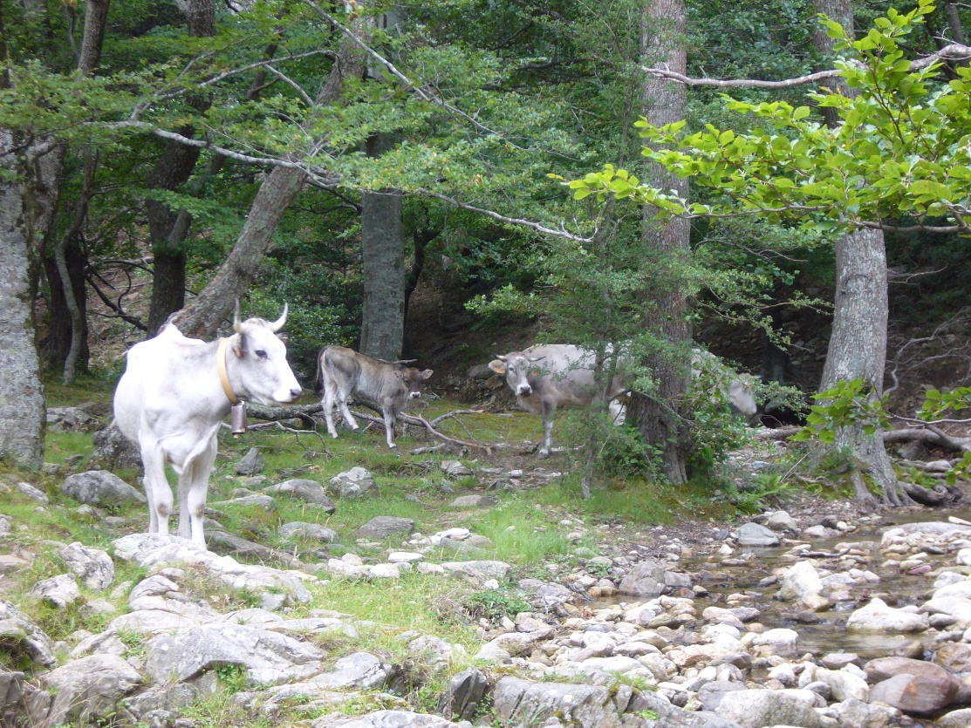
Recommendations
Monitoring of operations supported relevant for water
Member States should precisely monitor the resources allocated to Focus Area 4B “improving water management, including fertiliser and pesticide management”, as well as the output and outcomes achieved under this FA, as for FA 5A “increasing efficiency in water use by agriculture”.
Policy design
Direct Payments, as income support, should be better oriented toward holdings implementing less profitable practices beneficial for the environment.
Additional eligibility criteria should also be considered under Voluntary Coupled Support to ensure that sufficient pasture area is available by livestock unit, and avoid any increase of the nutrient pressure on water under livestock VCS.

Slide 24
Recommendations
Effectiveness of Cross-compliance and Greening measures
To further improve waterbodies’ status, higher requirements should be set under these schemes (e.g. ban of both fertilisers and pesticides on buffer strips)
Exemptions should be avoided (e.g. equivalent practices for maize monocropping).
The regulatory basis set by cross-compliance should be extended to farmers not benefiting from the CAP support (flower, fruit and vegetable producers) or other measures to limit their pressures on water should be found.
Water quantitative issues and climate change
Higher attention should be granted to water quantitative issues, and particularly to water savings. Support to irrigation systems should mainly concern the improvement of existing installations with effective water savings, controlled ex-post.
The creation of new irrigation systems should not be supported unless the global project involves less water-dependent farming systems with the implementation of alternatives (e.g. agroforestry, drought-resistant crops, shade nets, etc.).
Water reuse and corresponding equipment should also be more supported under the RDP M4 Investments measure, particularly in areas subject to water quantity issues, where alternatives to irrigated crops are deemed as not economically viable.

Slide 25
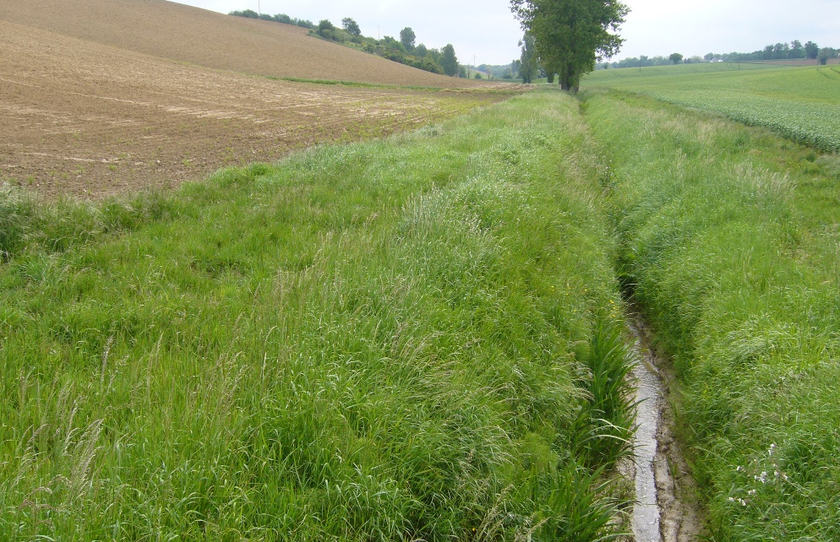
Recommendations
Favour the voluntary approach
Increase the attractiveness of the RDP measures. In. particular, payment rates delivered under M10 AECM should be increased for it to be a real incentive to farmers.
Better targeting of the measures
Provisions should be set in the legislation for Member States to orientate RDP measures with potential positive effects on water (e.g. M10, M11, M15) towards priority areas facing water issues, through the definition of eligibility and selection criteria

Slide 26
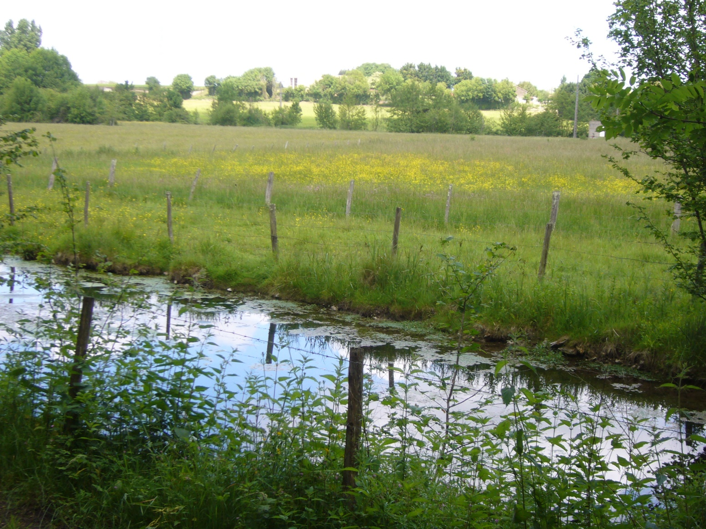
Thank you for your attention

