Slide 1
Evaluation support study on the CAP’s impact on knowledge exchange and advisory services

Slide 2
Agenda
Objectives and scope of the evaluation
Evaluation themes and support study questions
General approach to the evaluation
Evaluation process and timeline
Presentation of the team
Methodology
Information sources and tools
Case studies
Surveys
Limitations
Conclusions
Recommendations

Slide 3
Objectives and scope of the evaluation

Slide 4
Objectives and scope of the evaluation
Subject
Evaluation support study on the CAP’s impact on knowledge exchange and advisory services
Objectives
Evaluate the impacts of the 2014-2020 CAP on knowledge exchange and advisory activities, in areas under direct influence of the CAP
Assess the achievement of the specific cross-cutting objective for Rural Development: « fostering knowledge transfer and innovation in agriculture, forestry and rural areas »
Scope
CAP instruments and measures having direct (and to a lesser extent indirect) effects on knowledge exchange, advisory activities and innovation, in the agriculture and forestry sectors
Period: 1 January 2014 onwards (2019) while taking account of the 2007-2013 period for comparison
Geographic: EU 28 – (112 RDPs)

Slide 5
CAP measures and instruments concerned
Regulation | Articles and measures
1305/2013
EAFRD (RDR)
Measure 1: Knowledge transfer and information actions (Art. 14)
Measure 2: Advisory services, farm management and farm relief services (Art. 15)
Measure 16: Co-operation (Art. 35)
1306/2013
Horizontal
EIP: European Innovation Partnership (Art. 53)
NRN / RRN: National/Regional rural network (Art. 54)
1307/2013
Pillar 1
M3.1 – Quality schemes for agricultural products
M4 – Investments in physical assets
M6.1 – Setting up of Young Farmers (YF)
M6.4 – Innovation
M9 – Setting up of producer groups and organisations
M10.1 – Agro-environment and climate
M11.1 – Organic farming
M19 – LEADER (Art. 42-44)
1308/2013
CMO

Slide 6
CAP measures and instruments concerned
Regulation | Articles and measures
1305/2013
EAFRD (RDR)
1306/2013
Horizontal
FAS : Farm Advisory System (Art. 12 & 14)
1307/2013
Pillar 1
Direct payments – Greening (crop diversification, maintenance of permanent pasture, ecological focus area)
Coupled Support
1308/2013
CMO
Innovation in the wine sector (Art. 51)

Slide 7
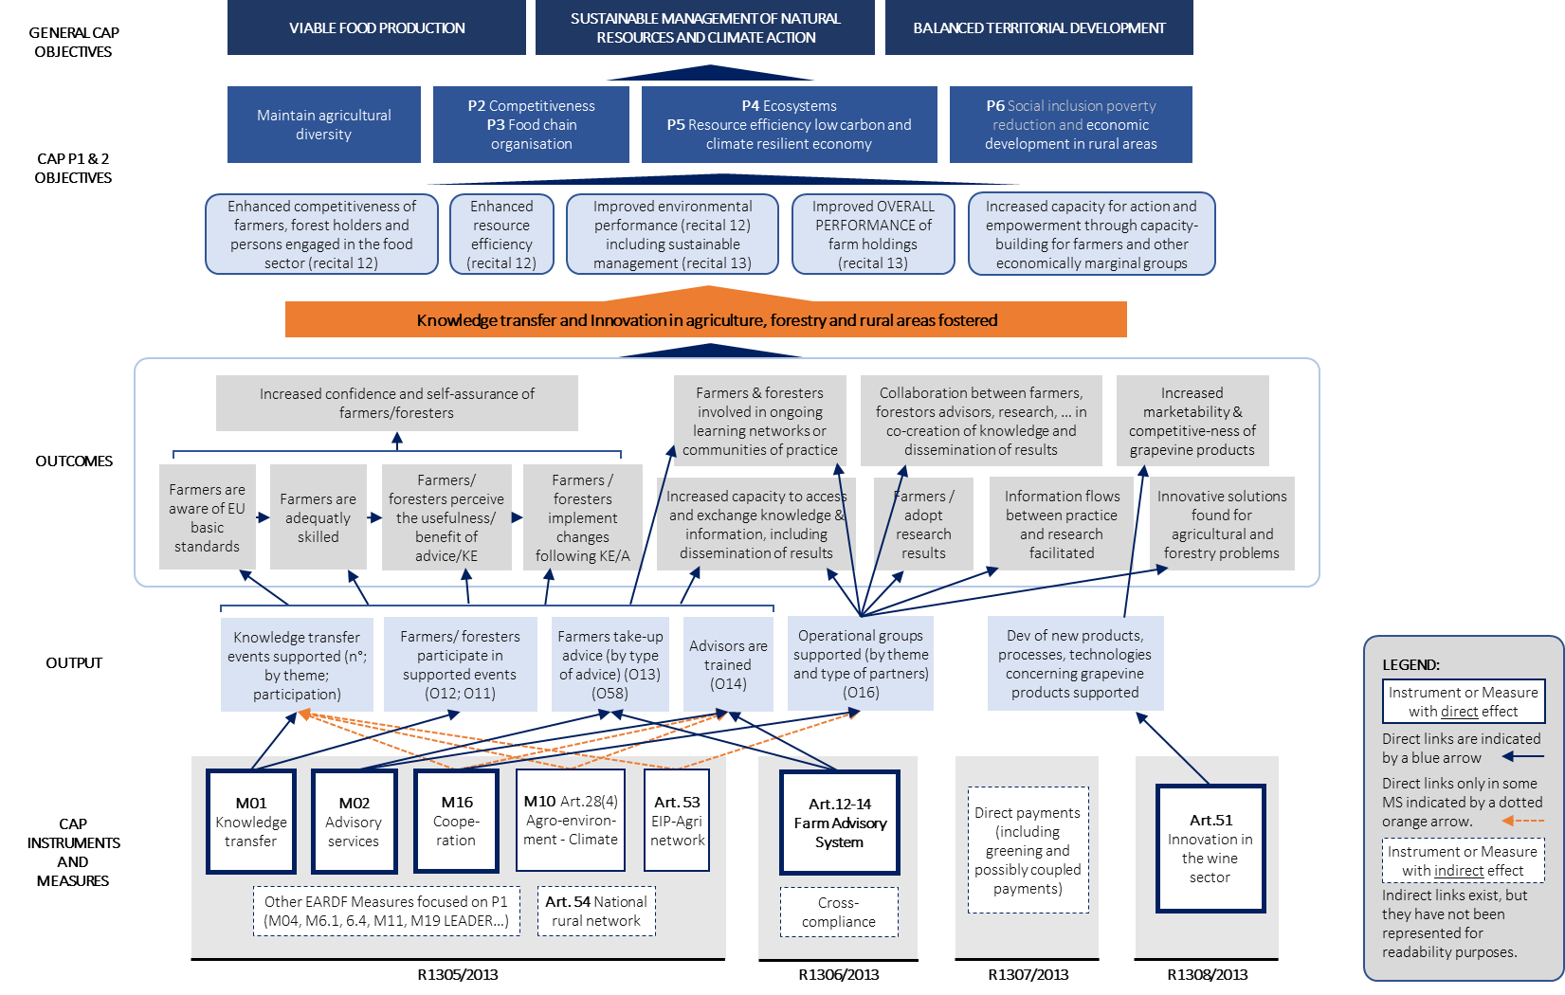
Intervention Logic

Slide 8
Evaluation themes and support study questions

Slide 9
6 Themes & 16 Evaluation support study questions
Theme 1
Theme 4
Theme 5
Theme 6
Coherence (ESQ 12-13)
Causal Analysis (ESQ 1-3)
Theme 2
Effectiveness (ESQ 4-7)
Theme 3
Efficiency (ESQ 8-11)
Relevance (ESQ 14-15)
EU added-value (ESQ 16)

Slide 10
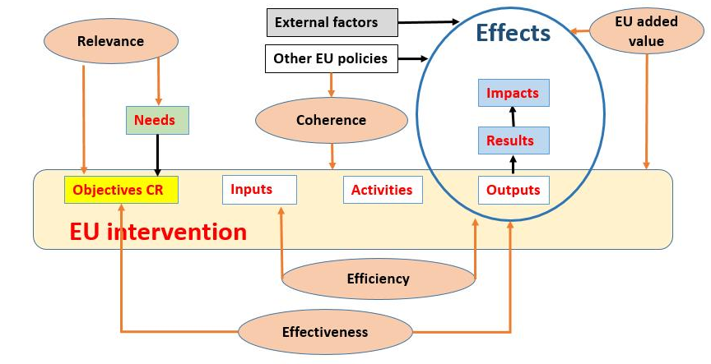
Structuring and understanding the ESQs
Link between evaluation criteria and the intervention logic:

Slide 11
General approach to the evaluation

Slide 12
General Approach
STRUCTURING
OBSERVING
ANALYSING
JUDGING
Previous literature and documentary analysis
Instrument & Measure inventory
Intervention logic
Case studies data collection and analysis
Conclusions and recommendations
Answer to ESQs
Selection of case studies
EU-28 data collection and analysis
Case studies restitution workshops
With triangulation of information sources and approaches.

Slide 13
Evaluation process and timeline
Phase 1
Structuring
Phase 2
Observing
Phase 3
Analysing
Phase 4
Judging
1.5 months
3 months
3 months
1.5 months
1.5 months
2.5 months
1 month
September/Mid-October
Mid-October/November/ December/Mid-January
Mid-January/
February/March/
Mid-April
Mid-April/May
June/Mid-July
Mid-July/
August/
September
October
T1.2 Establish intervention logic
T1.3-1.6 Draft analysis of the ESQ, elaborate the general approach and prepare the evaluation tools
T1.7 Provide approach to the selection of CS
T1.1 & T1.8
T2.1 Collect information and report about it
T3.1 Replies to ESQs 1-3 (causal analysis), 4-7 (effectiveness) and 12 and 13 (coherence)
T3.1 Replies to ESQs 8-11 (efficiency), 14 and 15 (relevance) 16 (EU-added value)
T4.1 Conclusions & recommendations
T4.2 Executive summary
T4.6 Compilation of the preliminary final deliverable
T4.3 Abstract
T4.4 Leaflet
T4.5 PowerPoint presentation
T4.7 Compilation of the draft final deliverable
T4.8 Compilation of the final deliverable
First
interim report
Second
interim report
Third
Interim report
Fourth interim report
Preliminary final
Draft final
Final report
Kick-off
2nd SG
3d
SG
4th
SG
5th
SG
6th SGM
26/09
22/10
28/01
27/04
10/06
27/07
SG
Steering group
T - task

Slide 14
Presentation of the team
Quality Assurance
J-M. Wathelet
Core Evaluation Team
Team Leader
Monika Beck
ADE
Janet Dwyer
CCRI
Francesco Mantino
CREA
Patrick Van Bunnen
ADE
ADE Team
Konstantin Gruev
Joanna Cozier
Aurore Ghysen
CCRI Team
Evgenia Micha
Katarina Kubinakova
John Powell
CREA Team
Simona Cristiano
Anna Vagnozzi
Mara Lai
OIR Team
Ambre Maucorps
Team of national experts (complement core team where necessary for the conduct of the MS/Regional case studies)

Slide 15
Methodology

Slide 16
Information sources and tools
Informed opinions collected at EU level
Comprehensive literature review (on the concept, evolution and diversity of AKIS, EIP-AGRI network, Farm Advisory Systems, existing and emerging needs in rural areas as well as critical factors of success; and of relevant research projects such as ProAKIS and AgriLink)
Interviews with key stakeholders (DG-AGRI, EIP-AGRI Service Point, ENRD Contact Point, JRC)
Participation in webinars (AgriLink, EIP-AGRI)
Two online surveys - RDP Managing Authorities and FAS coordinators
EU-level Data analysis
Documentary analysis (including extensive screening of 112 AIR 2018)
Financial data: ESIF database, CMEF indicators and targets from RDPs
Multi-variate principal component analysis and regressions (ESQ7)
JRC FAS questionnaire, where sufficiently accurate
Detailed quantitative and qualitative analysis at the level of case study Member states and regions (see following slides)

Slide 17
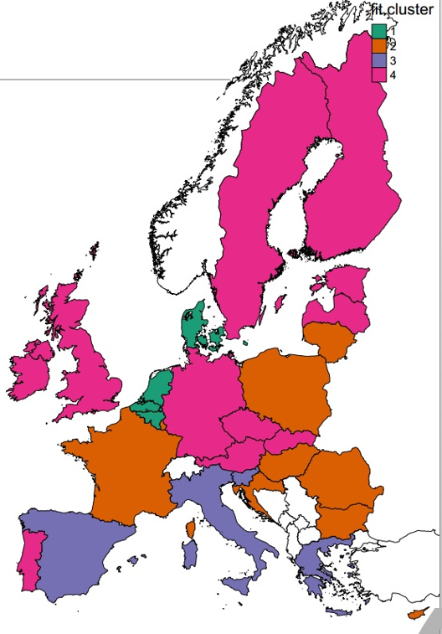
Case studies selection
Objective of the typology/clustering:
Cover the wide range of approaches across the EU in terms of knowledge exchange, innovation and advisory activities in the agricultural and forestry sectors
Approach:
Application of 5 criteria
Selection operated in 2 steps (clustering using R with K-means)
Selection of 4 clusters
Choice of 1-3 Member States per cluster
Selection:
eight Member States and nine regions namely in Flanders (Belgium), Estonia, Lorraine (France), Lower-Saxony (Germany), Ireland, Veneto and Umbria (Italy) and Poland

Slide 18
Case studies selection
Group 1 (3MS)
(1) important (first) in terms of political intention in T1 (2) first in terms of decision rate (3) first in terms of intensity (SO/AWU)
(4) Strong AKIS fragmented to medium
Group 2 (9MS)
(1) the lowest political intention in T1 (except HU) (2) the lowest decision rate (3) the second lowest productivity in terms of SO/AWU with exceptions (FR, LUX) (4) All types of AKIS except intermediate
Group 3 (5MS)
(1) a political intention in T1 above the average (2) the lowest decision rate (3) a relatively low in terms of SO/AWU
(4) Mainly weak and fragmented AKIS
Group 4 (11MS)
(1) a political intention in T1 around or above the average with some exceptions (PT, SK are lower) (2) a good decision rate (3) a relatively high in productivity SO/AWU (exceptions : LV, PT)
(4) Different AKIS types

Slide 19
Information sources and tools (cont.)
Detailed quantitative and qualitative analysis at the level of case study Member states and regions
Comprehensive literature review (both at national and regional levels, with valorisation of work performed by the Thünen Institute since 2007 with an essential contribution to the efficiency analysis)
Documentary analysis (2018 Annual Implementation Reports)
Interviews with :
the competent authorities
stakeholders involved in agricultural research and education, EIP-AGRI, rural networks and the forestry sector
trainers
advisors
and beneficiaries
Beneficiaries online (for Grand-Est in FR) or phone (for Lower Saxony in DE) surveys

Slide 20
Information sources and tools (cont.)
Multiple surveys:
MA survey
Opened on 20/01
Sent to 88 contacts (out of 112 RDPs; 18 appeared non-valid)
33 answers, from 10 MS
FAS survey
Opened on 12/02
Sent to 115 contacts (18 non-valid)
21 answers, from 17 MS
Final beneficiaries
Online survey – only in Grand-Est (Alsace, Lorraine, Champagne Ardennes): sent to 3,600 farmers, from 22/01 to 5/02 (142 answers)
Focus groups and/or phone call with farmers directly contacted in other CS MS

Slide 21
Limitations
Data availability and validity
No single database containing both budgetary data and their breakdown by sub-measures, which makes it necessary to use several distinct databases
Major differences in the methods used to calculate certain CMEF indicators between Member States, also allowing some multiple counting
Small decision rates and sometimes even very low spending rates for the relevant Rural Development measures
Absence of robust data on uptake of training/advice by farmers/foresters
Monitoring data of the FAS does not provide a comprehensive reliable view of the operation of the FAS (combination of all type of advice into a single indicator and impossibility for some regionalised Member States to provide a unique Member State response)
Time constraint for the case studies

Slide 22
Conclusions

Slide 23
Theme 1 ▪ Causal Analysis
CAP instruments and measures contribute to Member States’ AKIS but CAP support concerns only a small (very small part) of MS’ AKIS
More specifically:
Low awareness of the concept of AKIS among MA and stakeholders in CS MS
MS AKIS and CAP architecture are strongly influenced by the historical context of privatisation of advisory services (and implementation of the FAS) – current extraordinary diversity of situations across MS/regions
Administrative burden limits the use of CAP KE-I-A measures which are small financially, compared to other RD measures
No relation found between the architecture of CAP I&M (and their contribution to MS’ AKIS) and the characteristics of MS’ AKIS
The impact of the FAS on AKIS varies along a gradient, from ex post statement of preexisting elements to the provision of stimulus to use RD funding to rethink the whole advisory system and services proposed

Slide 24
Theme 2 ▪ Effectiveness
Effect on fostering knowledge exchange, innovation and advisory activities (KE-I-A)
Increased total budget for KE-I-A measures (M1-2-16) (compared to 2007-2013) but only due to:
the EIP-AGRI OGs and cooperation M16
the cross-cutting objective to foster KE-IA and T1 (% KE-I-A in total RDP)
Share remains relatively limited
M16: New cooperation measure, widely taken up by MS (showing in particular the success of the EIP-AGRI OGs innovative projects and effect of the EIP network)
M1: Planned by most RDPs but 13% budget reduction (compared to 07-13)
M2: 20% budget reduction (compared to 07-13)
Advice (as KE and innovation) is also supported by national public funds alone
Despite limited budget and administrative burden in implementation (see efficiency), CAP I&M contribute to foster KE-I-A, individually and taken together.

Slide 25
Theme 2 ▪ Effectiveness
Effect on fostering KE-I-A activities (2)
M1 for KE: output indicators are higher than expected relative to spent amounts (number of participants), but data are not collected consistently; no figures are available on uptake, and target population is often very broadly defined
M2.1 and FAS for advice:
M2.1 shows promising results, with more farmers advised than over the entire previous period, covering a large scope of topics (FAS themes and many others). Many MS assimilate M2 and the FAS.
M2 is combined to other measures in a few MS – however its implementation is limited by administrative burden (see efficiency)
From CS MS with advanced implementation (DE-LS, EE, FR-LO, IE), KT and A fostered the adoption of standards and led to improve farming and management practices beyond standards.

Slide 26
Theme 2 ▪ Effectiveness
Effect on fostering KE-I-A activities (3)
M16.1 promoting a bottom-up approach with direct contribution of farmers to innovation: demonstrated success of the OG dynamic with its co-creative search for solutions to needs/opportunities of farmers and foresters. (1600 OGs currently = 50% of the target)
Importance of “Innovation support services”, NRN/RRN, other facilitators
Information flows are key for an integrated and effective AKIS (farmer-advisor; advisor-researcher; farmer- research) supported by the EIP-AGRI
→ Limits and challenges to OGs:
Involvement of farmers
Dissemination of results
No evidence in terms of impact yet (too short perspective)
Other measures fostering KE-I: LEADER (M19), NRN, H2020 (through M16), LIFE, Interreg

Slide 27
Theme 2 ▪ Effectiveness
Lifelong learning (LLL) and vocational learning
CAP I&M promote LLL and vocational training:
Directly, through support of training and advisory activities (M1 and M2)
Indirectly, through requirements and conditions (start-up support, investment, etc.), but the possible synergies between measures remain under-exploited and pre-requisite training/advice is often funded by national/regional funds (outside the CAP)
Entry and maintenance of adequately skilled farmers
CAP I&M supported the entry/maintenance:
Directly, through support of training and advisory activities (M1 and M2)
Directly through the obligation to implement a FAS in each MS
Directly or indirectly through specific requirements, such as the conditions on start-up support (M6.1) that contributed to increase the young farmers’ level of qualification and the AECM (M10) that make expert advice conditional for support
Agricultural advice remains an essential lever to change farmers’ practices
The FAS increased farmers’ awareness of advisory services and also of regulatory requirements. Together with M2, it improved advisors’ training.

Slide 28
Theme 3 ▪ Efficiency
How efficiently CAP I&M help to improve AKIS functioning, information flows and knowledge acquisition?
Limited evidence that CAP I&M significantly increased the reach of KE-I-A (around 10% of farm holdings and around 20% of CAP beneficiaries). Not a priority for the MS?
Mixed evidence on cost-efficiency, but still room for improvement (with higher skills in managing demand, more efficient delivery of KE services, and targeting of beneficiaries as the most prominent needs)
The EIP-AGRI Service Point and its activities are expected to be efficient, and an important and valuable addition to AKIS efficiency across MS
Targeted training of advisors efficiently enhances AKIS functioning
Heterogenous cost/benefit proportion of the FAS (limited in MS where the advice offer is comprehensive and embedded in a strong and integrated AKIS, with a benefit outweigh of the FAS-M2 package in MS with intermediate AKIS, up to substantial contribution in terms of topics and quality in MS with weak and fragmented AKIS)

Slide 29
Theme 3 ▪ Efficiency
Administrative burden
Low RDP spending rates (31% M1, 17% M2, 18% M16 versus 53% for all RD measures) are an evidence of administrative burden
Distinction between different levels:
Beneficiaries: burden is negligible for training and advice (transfer to operating bodies), and quite important in OGs (who were in a learning process in 2014-2020)
Public administration and intermediary bodies (service providers): burden is high (public procurement rule, learning process for EIP, use of simplified costs at inadequate level and for OGs, proportionality of controls)
EU officials: strong initial efforts for the new EIP-AGRI measure

Slide 30
Theme 4 ▪ Coherence
Internal coherence within the CAP
Stronger link of the legal framework of the CAP (common objectives and CMEF)
But no common programming for EAGF and EAFRD (contrary to ESIF) - Pillars 1 & 2 are managed by distinct authorities
The FAS addresses greening and cross-compliance common to both pillars
Within Pillar 2, clear search for increased design coherence through its architecture, innovation cross-cutting objective and KE-I Priority 1
But envisaged complementarities and synergies are not fully implemented. The design remains complex. Measures are still largely managed “in silos” at the level of administrations; there is still a lack of flexible and combined use of KE-I-A measures and sub-measures, and synergies with other RD measures,

Slide 31
Theme 4 ▪ Coherence
External coherence
ESIF (ESF, ERDF): common programming, clear demarcation lines, but no evidence from case study MS of complementarities and synergies
Horizon 2020: recognised coherence at EU/national level and successful synergies with the EIP-AGRI in some MS (front-runners)

Slide 32
Theme 5 ▪ Relevance
Regarding beneficiaries’ current and emerging needs
☺ Topics: legal provisions allow to cover all relevant KE-I-A topics, no restrictions
😐 Methods: EU framework quite broad (with an exception of 1-1 advice), but MS feel limitations also compared to their own initial scoping
The SWOT is a step forward in needs’ identification and focus on specific topics. However, possibly due to administrative burden, only a small share of KE-I-A is supported by the CAP and there is no information on the coverage of these needs with national resources
Regarding EU/national/regional policies
The actual contribution of the CAP to fostering KE-I-A is difficult to establish when national funding is also provided
There is evidence that EU & MS networks and institutional developments (EIP-AGRI, etc.) fostered new functionalities (farmer learning; strengthening links between research, innovation and practice). Until now, the number of farmers involved directly in the projects is small, but the impact goes beyond those.
Regarding the FAS obligation
Financial support to the FAS through M2 is valuable especially in MS with weak AKIS

Slide 33
Theme 6 ▪ EU value added
There is evidence of the CAP added-value in fostering KE-I-A (despite administrative burden)
EIP-AGRI is highly valued: the promotion of bottom-up approaches focusing on farmers’/foresters’ needs and co-creation is significantly positive to fostering KE-I-A
Cross-cutting consideration of innovation (Priority 1)
RD support enables additional achievements in KE and advice, and the extension of services’ offer
CAP encouraged a key evolution in terms of:
Methods
Thematic coverage

Slide 34
Recommendations

Slide 35
Recommendations
1. Develop an integrated vision of MS’s AKIS
In preparing their CAP strategic plans, MA should develop a comprehensive vision of their AKIS (also at regional level in regionalised MS)
Based on assessment of the existing AKIS, its strengths and weaknesses, the needs and interconnections
Build a strategy based on short- and medium-term vision to strengthen and adapt the system to needs
Emphasis put on information flows between actors and between the various geographical levels

Slide 36
Recommendations
2. Strengthen coherence between CAP instruments and measures and MS’s AKIS
Based on a comprehensive view of the existing AKIS, CAP I&M can be used to:
cover needs in terms of KE-I-A in line with the national/regional strategy
strengthen the system and information flows were needed
Ensure an ‘AKIS concept’ promotion at EU, national and regional levels to make MA/stakeholders familiar with it.

Slide 37
Recommendations
3. Maintain and develop the EIP-AGRI
Ensure an “EIP-AGRI promotion strategy” in all MS and ensure that the EIP-AGRI is well integrated in MS’s AKIS
Setup innovation support services. Together with an EIP-AGRI extended Service Point and dedicated innovation strand, they should:
Promote overall the EIP-AGRI and OGs
Support the concrete implementation of OGs
Implement strategies for results’ dissemination
Improve the information flows to and from farmers
Address the current barriers to further encourage farmers’ and advisors’ involvement in OGs
Identify and record the results and impacts of OGs

Slide 38
Recommendations
4. Foster information flows between advisors and both farmers and research
Setup incentives for advisors’ initiatives to:
communicate farmers’ needs
disseminate knowledge
5. Maintain training and knowledge support for advisors
Provide training in various forms and upskilling for advisors
Encourage MS to link funding of advice to training of advisors

Slide 39
Recommendations
6. Foster holistic advice in response to farmers’ needs including topics of public interest
Advice really needs to be adapted to the farmers’ needs
Include topics of public interest but also advice on the economic and environmental performance of the farms, adapted to each local situation
7. Increase the ability of all farmers to access advisory services and promote advisory activities while enabling approaches to evolve
Guarantee access to high-quality advice for all EU farmers (taking into account the specificities of their farm)
Ensure financial resources to support these activities and their promotion by AKIS actors and other stakeholders
Complement on farm one-to-one advice by other approaches

Slide 40
Recommendations
8. Place more emphasis upon reaching the ‘hard to reach”
Provide specific CAP funding targeting these groups for KE-I-A adapted to their specific needs
Develop strategic approaches to foster the most efficient balance of public, private and hybrid forms of KE-A.
9. Improve ‘targeting’
Target activities to those CAP beneficiaries and farmers where the needs for advice and training are the greatest
Increase awareness of how CAP KE-I-A measures can target excluded groups and strengthen capacity/governance in these contexts

Slide 41
Recommendations
10. Support knowledge exchange, advice and innovation methods based on new technologies
Enable measures to finance KE-I-A activities based on new technologies
Enable measures to finance activities to train/advice end-users on how to use new technologies and methods
11. Reduce administrative burden (1)
Key to:
Improving the implementation of measure
Ensuring understanding by the managing authorities and beneficiaries
Reducing transaction costs

Slide 42
Recommendations
11. Reduce administrative burden (2)
Within the sphere of policy design and management:
Maintain intermediate bodies
Facilitate the setting up of OGs
Simplify public procurement process for small and innovation projects
Proportionate management and control for small projects
Provide training to MAs and Paying Agencies
Withing financing issues:
Provide advance payments
Introduce flexibility in standard costs
Introduce flexibility in financial allocation by Focus Area (for remaining 2014-2023 period)
Eliminate all thresholds for advice

Slide 43
Recommendations
12. Revise and specify data collection of evaluation and monitoring indicators
Setup clear common definition of beneficiaries (farmers, advisors, etc.)
Setup clear and identical definition of training/advice units
Setup registration of participant on the basis of a single user-ID (only data to assess uptake of training/advice by the farming population)
Focus data collection of advisory activities on the main types of advice
Monitor separately other types of advisory or KE activities (growing diversity and implementation)
Identification of the results and impacts of advice on changes in farming practices (in evaluation activities)

Slide 44
Monika Beck
Patrick Van Bunnen, Jean-Marie Wathelet, Joanna Cozier, Aurore Ghysen – ADE
Janet Dwyer, Nenia Micha, Katarina Kubinakova - CCRI
Francesco Mantino - CREA
Team Leader
Monika.Beck@ade.eu
Evaluation team

