Slide 1
Evaluation of the impact of the CAP on habitats, landscapes and biodiversity
Final Presentation
November 2019

Slide 2
Scope and objectives of the evaluation
To evaluate the impacts of the 2014-2020 CAP on habitats, landscapes and biodiversity
To determine the extent to which the CAP contributed to Target 3 of the EU Biodiversity Strategy
Addressed through 15 evaluation study questions (ESQs)
Effectiveness
Contribution to CAP biodiversity objective (ESQ4)
Contribution to conservation status (ESQ5)
Efficiency
CAP results vs. budget (ESQ9)
Administrative burden and simplification (ESQ10)
Impact of biodiversity on agriculture and forestry (ESQ6)
Successful approaches (ESQ8)
Coherence
Internal coherence with CAP biodiversity objective (ESQ11)
Internal coherence with other CAP objectives (ESQ12)
Relevance
EU Added Value
Relevance to needs and new issues (ESQ14)
EU added value (ESQ15)
Relationship with national and regional biodiversity (ESQ7)
External coherence (ESQ13)
Causal Analysis
Drivers and reasons of implementation choices (ESQ2)
Impacts on land use patterns, intensity of land use and distribution of production (ESQ3)
CAP implementation choices (ESQ1)

Slide 3
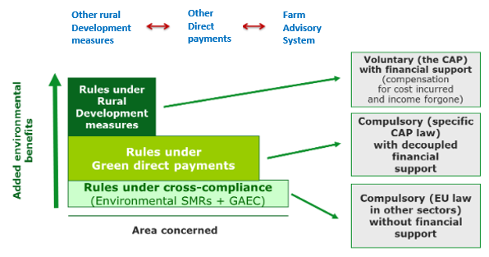
EU Biodiversity framework and the CAP
EU Biodiversity Policy Framework for Agriculture and Forestry
Key elements of the CAP (2014-2020) relevant for biodiversity and landscapes
Convention on Biological Diversity (CBD)
NBSAPs*
EU Biodiversity Strategy 2020* (Targets 3a and b¹)
Nature Directives
EU Biodiversity Strategy 2020* Targets 3a and b¹
PAFs for Natura 2000
¹Achieve more sustainable agriculture and forestry
*National Biodiversity Strategies and Action Plans - Main tools to implement the Convention on Biological Diversity (CBD)
Source: Adapted from European Commission, 2016

Slide 4
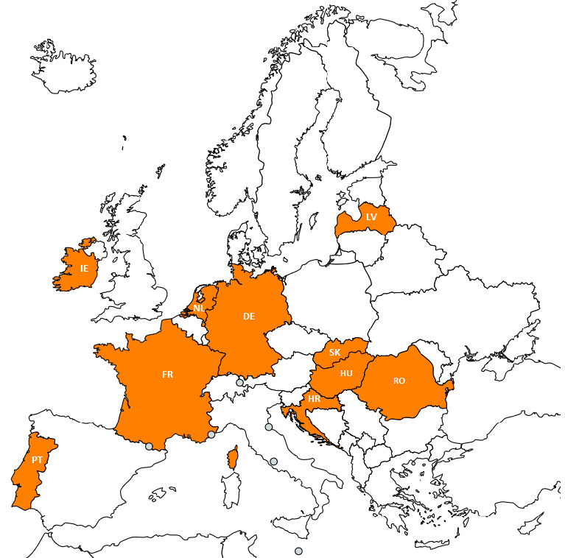
Methods and Data used
Methods | Data
Literature and evidence review on the effects of farming practices associated with CAP measures on biodiversity Analysis of EU-28 and Member State statistical data Case studies in 10 Member States (see map) | Member State information on implementation of CAP horizontal, Pillar 1 and 2 instruments and measures Results from previous evaluations including greening and forestry measures Indicators from the CAP CMEF Statistical data from FADN and Eurostat
Limitations
Establishing a true counterfactual to identify CAP net impacts as opposed to other factors
Absence of data for this programming period, including data for many statistical indicators as well as peer-reviewed literature
Some instruments and measures with biodiversity impacts are designed and implemented for other purposes – monitoring data therefore rarely investigate biodiversity effects
Reliability of information provided by stakeholders including through interviews
Difficulty of scaling up results from case studies to form generalised judgments at EU level
Solution: Triangulation of evidence sources; clarity on sources and assumptions made

Slide 5
CAP Instruments and measures assessed
Majority of CAP instruments and measures are in scope including those with direct and indirect impacts on biodiversity – established through the intervention logic
Key CAP instruments and measures assessed
Horizontal measures | Pillar 1 | Pillar 2
Cross compliance Farm Advisory System | BPS/SAPS Greening payments Voluntary coupled support | Knowledge transfer and information actions (M1) Advisory services, farm management and farm relief services (M2) Investments in physical assets, including non-productive investments (M4) Forest Investments (M8) Agri-environment-climate (M10) Organic farming (M11) Natura 2000 payments (M12) ANC payments (M13) Forest environment-climate (M15) Cooperation (M16)

Slide 6
EU Biodiversity Strategy progress and the CAP
EU Biodiversity Strategy 2020 - Mid-term Review 2015
Target 3a (Agriculture) |  |  | Target 3b (Forests)
Overall Assessment: No significant overall progress (much stronger efforts are needed to meet the target by its deadline)
Action 8: Enhance CAP direct payments | Action 9: Better target rural development | Action 10: Genetic diversity | Action 11: Encourage forest conservation | Action 12: Biodiversity measures in forest plans
Agricultural and forestry ecosystems are still declining at a rapid rate*
Agricultural intensification, land abandonment, and intensively managed forests continue to be key threats to biodiversity
Review concluded that opportunities under CAP need to be taken up by MS at sufficient scale to address these challenges
Source: European Commission, 2015
*Based on MS 2007-2012 Nature Directives reporting

Slide 7
Biodiversity status in agricultural and forest habitats and species
Source: EEA (2019) preliminary data based on MS 2013-2018 Nature Directives reporting

Slide 8
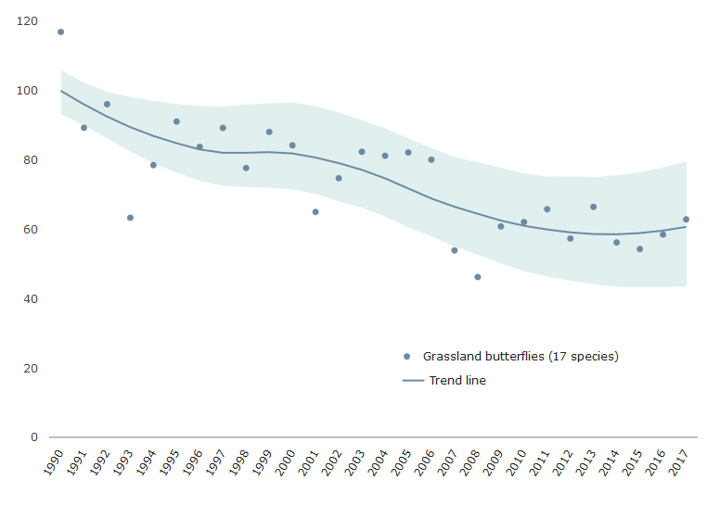
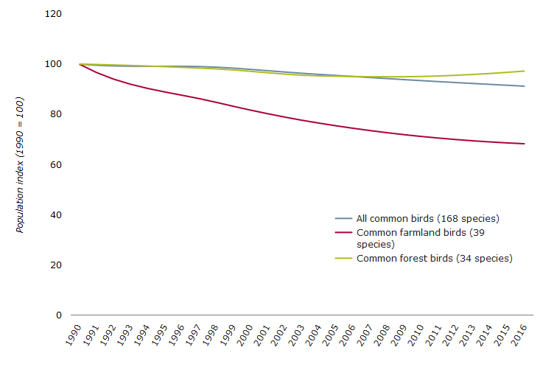
Abundance and distribution of relevant species
Grassland butterflies - population index, 1990-2017
Common birds - population index, 1990-2016
Source: EEA, Butterfly Conservation Europe, European Butterfly Monitoring Scheme partnership, Assessing Butterflies in Europe (ABLE) project
Notes: Compiled by EEA refers to BE, EE, FI, FR, DE, IE. LT, LU, NL, PT, RO, SL, ES, SE, UK
Source: European Bird Census Council, RSBP, BirdLife International, Czech Society for Ornithology
Notes: Compiled by EEA refers to EU-28 (except HR, MT) + Norway and Switzerland

Slide 9
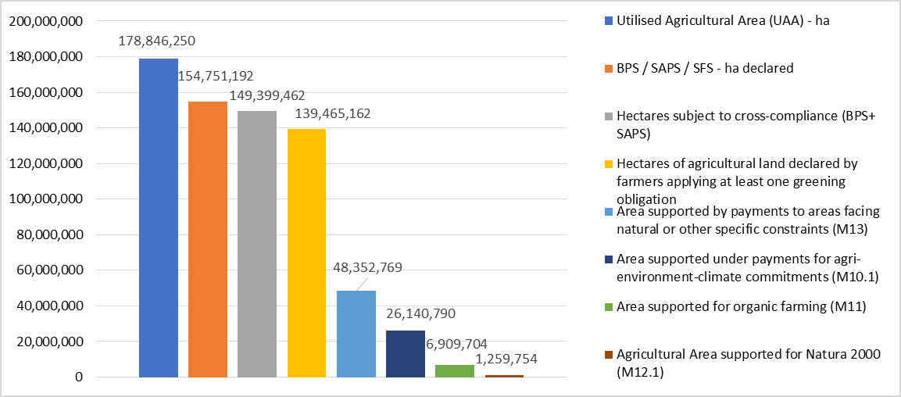
Implementation in Member States (1)
Member States have considerable flexibility about how they implement CAP Pillar 1 instruments and all Pillar 2 measures related to biodiversity
78% of EU agricultural land was subject to at least one greening obligation in 2017
Pillar 2 measures which tend to have greater a biodiversity focus covered significantly smaller areas of EU agricultural land in 2017 e.g. M10.1 (14.6%), M11 (3.9%) M12 (8.9% of Natura 2000 areas)
0.7% of the total forestry area was supported under M12 in 2017. However forest measures outside Natura 2000 areas have experienced low uptake to date compared with the targets set
Provision of biodiversity relevant information/ advice and means of communication under Farm Advisory System differs significantly
Area supported under different CAP instruments and in the EU-28 in 2017 (ha)
Source: DG AGRI Data portal (UAA: Eurostat: apro_cpsh1; BPS/SAPS: CATS (OID_01_2a &OID_02_2b); Cross-compliance CATS & RDIS (OIH_01_1a); Greening (ISAMM Greenings OID_05_3); M13 (CATS - OIR_06_1.4); M10 (CATS - OIR_06_1.1); M11 (CATS OIR_06_1.2); M12 (CATS OIR_06_1.3)

Slide 10
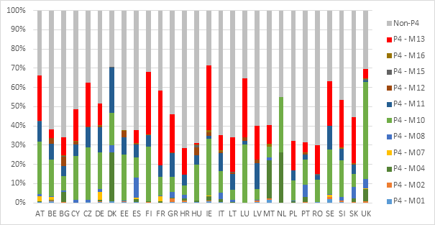
Implementation in Member States (2)
Member States allocated almost 47% of their Pillar 2 budget to Priority 4 on average - ranging from 28.5% (HR) to 71.5% (IE)
Greatest proportion of the P4 spending was allocated to the AECM (M10) and ANC measures (M13) 35.2% each, the organic farming (M11) and forest measures (M8 and M15) were allocated 15.7% and 4.9% respectively
Since the beginning* of the programming period overall MS have increased the amount programmed to P4 by about 3%
Broadly equal numbers of RDPs increased or decreased planned spending on biodiversity measures over that period *refers to 2016-2018
Planned Priority 4 expenditure broken down by measure per MS
Source: European Commission, European Structural and Investment Funds, ESIF 2014-2020 Finance planned details. Notes: Proportion of spending allocated to Priority 4 under Pillar 2 gives an indication of the biodiversity focussed expenditure in each MS. However, Priority 4 can also relate to expenditure on other ecosystem services, such as water and soils

Slide 11
Drivers of implementation choices
For Member States | For beneficiaries
Main drivers were socio-economic, financial and administrative issues Biodiversity and other environmental objectives - often a secondary concern* For greening measures, there was a strong emphasis on simple design, offering instruments and measures requiring minimal changes to farm practices and seeking to minimise administrative burden For AECM most schemes involved a mix of broad and shallow alongside more targeted options Environmental authorities’ involvement often limited to AECM design, rather than overall strategic design of CAP | Uptake influenced by a combination of financial factors, policy design, alignment with existing practices, environmental awareness and market developments Most popular instruments and measures were those that supported the maintenance of existing practices particularly in extensive grassland areas as well as arable Level of payment is often considered too low to compensate for the loss in production for schemes requiring changes in management practices in arable areas Other important determinants include the ease of application and controls, awareness and understanding of environmental issues, availability of advice
*Including those in NSABPs and PAFs

Slide 12
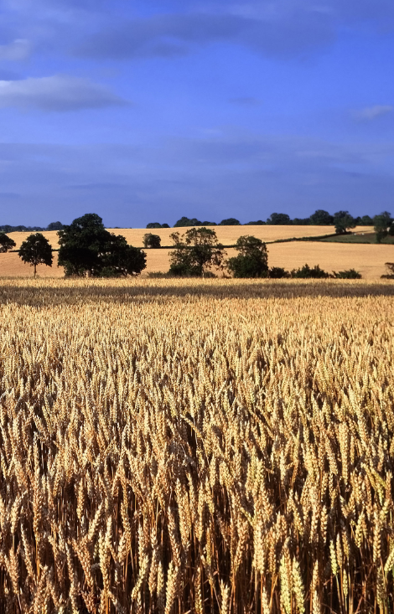
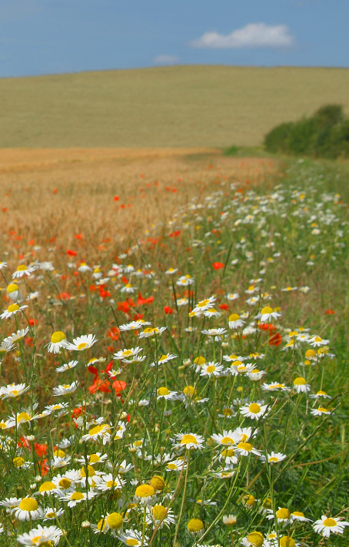
Impacts of implementation choices on land use, intensity and distribution
Land use, intensity and distribution of production are affected by many factors, therefore it is difficult to attribute any particular change from the CAP instruments or measures alone.
Pillar 1 greening measures have the potential to influence land use to some extent e.g. the ESPG measure protects about 5 million hectares (1/3 of permanent grassland), but only 0.3 million hectares (1% of permanent grassland) outside Natura 2000.
Pillar 2 AECM (M10) influences intensity of land management e.g. 8.9 million ha under extensive grassland management (11.6% of EU’s HNV farmland); 5.7 million ha of arable and permanent cropland under reduced fertilizer/pesticide use (4.9% of land)
Some studies highlight that payments which increase farm incomes may enable investments to be made that allow land to be farmed more intensively. However, the study did not find evidence of this occurring in practice.
© David Hughes/Shutterstock
© Bildagentur Zoonar GmbH/Shutterstock

Slide 13
Effectiveness: General contribution to biodiversity objectives
Pillar 1
Greening measures have made a limited contribution to biodiversity:
ESPG is the most important measure to support the protection of grassland habitats. However, its overall effectiveness is limited given the low levels of grassland designated and declared both inside and outside Natura 2000
EFA: Potential biodiversity benefits of fallow land, multi-annual fodder crops and landscape features not being fully realised as the most commonly declared EFA elements are catch crops and nitrogen fixing crops which have low biodiversity benefits
Pillar 2
AECM (M10) is most effective, particularly schemes tailored and targeted to specific biodiversity needs with sufficient scale. However, effectiveness is constrained by limited budgets and uptake
Natura 2000 (M12) is infrequently used by MSs to support the management of Natura 2000 sites, especially on forestry habitats
Organic farming (M11) has contributed to the increase in organic farmland area, with biodiversity benefits expected particularly on intensively managed farmed landscapes
ANC (M13) is likely to contribute to the maintenance of HNV farmland and semi-natural habitats, but evidence of impacts on biodiversity are lacking and support may also lead to agricultural improvements and biodiversity damage
Forestry measures (M8, M15) are infrequently used by MS for biodiversity purposes and information on impact remains limited
Knowledge transfer and advisory services (M1, M2) infrastructural investments (M4), and cooperation actions (M16) may also deliver biodiversity outcomes, especially when used in combination with the above measures, however the budget allocations remain relatively low
© Fotokostic/Shutterstock

Slide 14
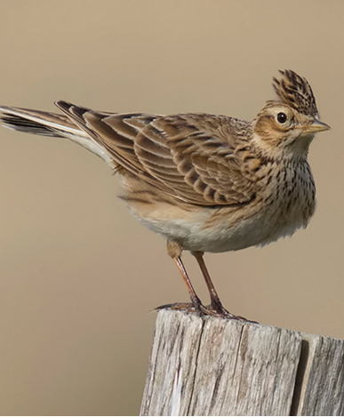
Effectiveness: Contribution to protected habitats and species
MS reporting data indicates that a high proportion of EU protected habitats and species are affected by agricultural and forestry practices
Especially conversion to arable and grassland / arable intensification
High proportion of forest species also affected by forestry activities
Effectiveness of CAP instruments and measures for habitats and species is similar to their contribution to biodiversity generally
AECM, Natura 2000 and forest ecosystem/environment measures have the greatest potential to support semi-natural habitats and HNV farmland
However, due to limited budgets for AECM and sometimes low uptake by farmers the scale of their implementation has often been insufficient to meet their potential
© Steve Ashton/ British Trust for Ornithology

Slide 15
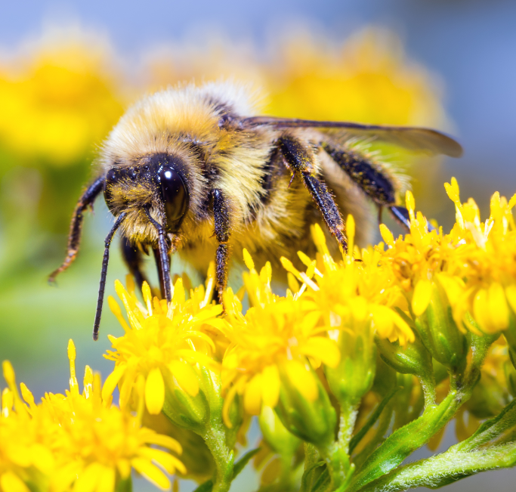
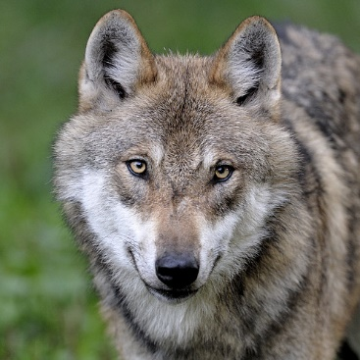
Effectiveness: Co-existence of biodiversity and farming
Study examined coexistence with protected species (large carnivores and geese) as well as wild pollinators and wild biological control agents
A wide range of CAP measures have significant potential to support improved coexistence in farming systems, including awareness raising amongst rural communities
Measures used to support coexistence with large carnivores and geese focus on:
damage prevention (e.g. fencing, livestock housing, use of dogs) and
farming system management (e.g. HNV pastoral systems and sacrificial arable crops)
AECM (M10) and investment (M4) measures are typically used
Other measures are not sufficiently used: e.g. specialist advisory services (M2), Natura 2000 management plans (M12), multi-stakeholder approaches (M16)
In some cases state aid or other sources are used to fund co-existence actions (both damage prevention and farming system management)
EU level, national and regional networks that support effective practical co-operation are playing an increasingly important role
© Sergey Lavrentev/Shutterstock
© Ralph Frank / WWF Germany

Slide 16
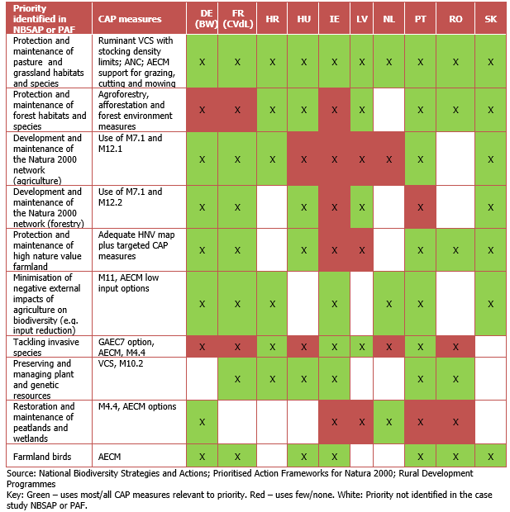
Effectiveness: Relationship with biodiversity strategies
Good alignment between the Member States’ biodiversity priorities identified in their NBSAPs and PAFs and those reflected in RDP SWOT and needs assessments
Alignment between biodiversity priorities and how Member States use P1 instruments and P2 measures in practice is more mixed:
Good alignment with priorities for grassland habitats and species, farmland birds, plant and animal genetic resources, minimising the external effects of agriculture on biodiversity;
Less good alignments with priorities for forest habitats and species, peatlands and wetlands and invasive alien species
Effective cooperation between Member States’ agriculture and forestry officials and those responsible for biodiversity varies significantly and can influence alignment

Slide 17
Effectiveness: Successful implementation – approaches and critical factors
Ensuring clear, specific and targeted biodiversity and landscape objectives are identified
A science-led approach to design, testing, revising and implementing schemes to achieve identified objectives
Developing packages of CAP instruments and measures that can be used in a coherent and targeted way at farm and landscape level
Ensuring that the eligibility criteria enable all land requiring biodiversity management to receive the necessary support
Investing in scheme training and on-farm advisory and facilitation support that recognises and develops farmers’ biodiversity knowledge and skills
Ensuring that mechanisms for monitor and evaluating the biodiversity impacts of schemes and using results to improve scheme design and implementation

Slide 18
Efficiency: CAP results vs. available budget
CAP instrument and measures with direct and indirect impact on biodiversity can demonstrate mixed results in terms of overall cost-effectiveness
Measure | Strengths | Weaknesses
Area of Natural Constraint (M13) | Focuses on farms in areas where grassland likely to be of high biodiversity value | Preferred by Member States when other measures might be more effective, reducing efficiency for a given budget
Agri-environment-climate (M10) | Better targeting has a clear benefit | Many M10 options have achieved extremely low uptake
Organic farming (M11) | Organic farming contributes positively to biodiversity especially on intensively managed farms | Hard to calculate right level of support
Greening measures | ESPG is applied efficiently when all valuable grasslands habitats are designated. Some EFA elements include high potential to deliver biodiversity benefits e.g. landscape features | ESPG designations largely confined to Natura 2000. The EFA instrument could be optimised by removing elements with limited benefit to biodiversity e.g. catch crops

Slide 19
Efficiency: Administrative burden and simplification
Administrative burden of the biodiversity measures is generally proportionate. Most is associated with the AECM and greening.
Complex application procedures and controls are justified by the high degree of targeting and specificity of AECM contracts in particular
Efficiency gains are available to MS who
Reduce EFA mapping costs by not offering landscape features as an EFA option if they are already protected through cross compliance GAECs , and avoid disproportionately precise measurement Remove or modify M10 options with very low uptake Streamline application procedures so that data already available to the MS is not asked for a second time Maintain a stable and coherent list of eligibility criteria.

Slide 20
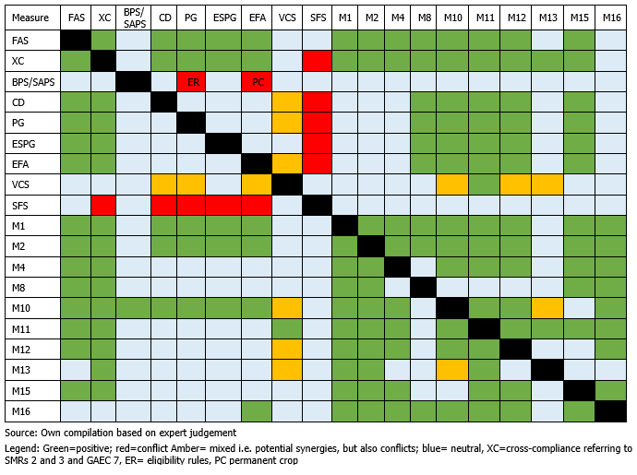
Internal coherence with biodiversity objective
Majority of CAP instruments and measures are coherent or do not interact. However coherence varies depending on the relationship between different instruments and measures
Numerous opportunities exist for measures to be combined in ways which are synergetic – e.g. AECM, organic farming, Natura 2000, non-productive investments, advice.
More of a mixed coherence between the VCS and ANC measures and biodiversity objectives.
Only a few instances exist where the relationship between measures could lead to contradictory outcomes. These issues largely apply to certain exemptions. In particular:
permanent crops in receipt of direct payments are not subject to relevant greening practices, notably the EFA instrument (7% of the UAA)
Farmers under the small farmer scheme are exempt from both cross compliance and greening requirements (5% of the UAA)

Slide 21
Internal coherence with other CAP objectives
Viable food production & balanced territorial development objectives
Instruments and measures related to biodiversity are generally coherent. Theoretical incoherence rarely occurs on the ground or only to a limited extent e.g. greening has had little impact on agricultural income and productivity due to flexibilities applied
RDP measures in principle compensate farmers for the income foregone and additional costs they incur when enrolling in these schemes, so they should also have limited or no impact on farmers’ income
Evidence from the case studies shows that biodiversity related RDP measures (M10, M11, M12, M8.5) can deliver synergies with the objective of balanced territorial development e.g. adding value to products or tourism
Other environmental objectives of the CAP
Coherence with the objectives of water, soil and GHG emissions tend to arise indirectly as a side effect of measures to promote biodiversity

Slide 22
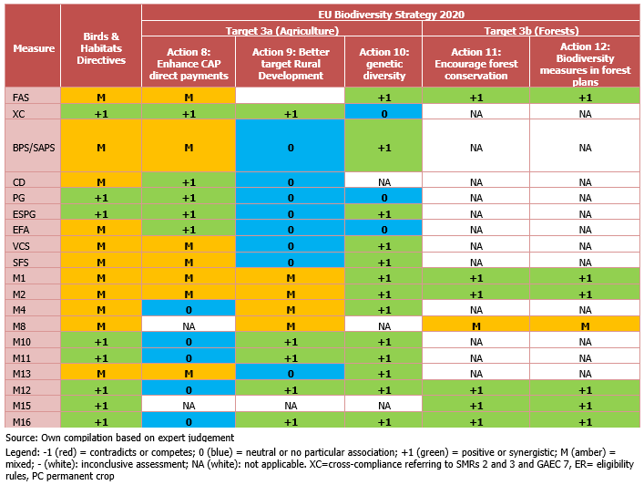
External coherence (BHD and EU Biodiversity Strategy)
EU level
Most of the CAP instruments and measures are potentially coherent with other related EU and national policies relevant for biodiversity
Measures with the highest coherence are the ESPG measure, M10, M12, M15, M11 and M16
Some other instruments and measures have the potential to be both coherent and incoherent with biodiversity needs, depending on how they are implemented, including direct payments, some RDP measures and most notably VCS
Member State level
RDPs, and especially M10, are coherent with biodiversity priorities (taking into account PAFs and NBAPS to some extent) in most case study Member States
Some decisions on Pillar 1 instruments, especially the very limited ESPG designation outside Natura 2000 areas, conflict with biodiversity needs

Slide 23
Relevance to needs and new issues
CAP measures of most relevance to addressing the pressures and threats facing biodiversity are those that maintain and restore semi-natural agricultural and forest habitats and landscapes
Pillar 1 | Pillar 2
Cross compliance, GAEC and advisory measures have the potential to be relevant, but this depends greatly on the way in which MS apply them ESPG is very relevant, but it does not protect semi-natural grasslands from all potential pressures, such as increases in the use of fertiliser or drainage. VCS relevant to the maintenance of semi-natural habitat, but not as relevant if no environmental conditions apply Some EFA measures relevant, but the majority of the EFA area is dominated by catch crops and nitrogen-fixing crops of low relevance to biodiversity | M10, M12, M15 and similar RDP supported schemes (under M4.4, M7 and M8) are of highest relevance, as help to maintain HNV farmland and provide tailored interventions to respond to the needs of threatened high priority habitats and species. Relevance of M10, M8, M15 etc. is heightened if they are targeted towards Natura 2000 sites M10 of greatest relevance as it has the ability to provide tailored interventions that can maintain and restore semi-natural elements in the landscape, other important habitat features and apply relevant farm management practiced M11 is also of relevance, it mainly benefits generalist species, and its relevance varies considerably depending on the various practices that are carried out, and their context

Slide 24
EU Added Value
The CAP has raised Member States’ ambition for biodiversity, in particular by requiring minimum levels of expenditure on a group of measures within the RDP, all of which provide benefits;
EU-level knowledge-sharing such as that through the European Network for Regional Development Contact Point and EIP-AGRI has also added value to what Member States could have achieved at national level.

Slide 25
Conclusions
CAUSAL ANALAYSIS
Flexibility to design and target certain CAP Pillar 1 instruments and all Pillar 2 measures has led to a wide array of implementation choices, both in terms of the instruments and measures applied, their focus and the budget allocated
Both Member States’ implementation choices and farmers’ decisions to take up instruments and measures have been primarily driven by socio-economic and financial reasons rather than biodiversity concerns
EFFECTIVENESS
Pillar 2 measures including AECM schemes, Natura 2000 and forestry payments can contribute significantly to biodiversity goals, particularly where they maintain semi-natural habitats, and support HNV farmland. However impacts are often constrained by limited budgets and farmer uptake (e.g. M8, M10, M15), and infrequent use by Member States (e.g. M12)
Pillar 1 instruments e.g. ESPG greening measure and certain EFA elements can support biodiversity, but often do not reach their full potential due to poor design. Other direct payments and VCS, as well as ANC payments can support HNV farmland, but may also facilitate agricultural improvements and intensification, resulting in negative impacts for biodiversity
There is relatively good alignment between PAFs and NBSAPs priorities and those reflected in their RDPs. However, most case study Member States had not made use of the full range of CAP measures available to meet their priorities

Slide 26
Conclusions
EFFICIENCY
The ratio of costs to benefits have not been optimised for a number of CAP instruments and measures. For example, nearly all of the ANC measure budget programmed to Priority 4 was provided for socio-economic reasons and its intervention logic is not focussed on biodiversity
The administrative costs of the biodiversity measures have in general been proportionate, given complexities which can be driven by inherent difficulties in delivery rather than poor policy design
COHERENCE
Good coherence can be observed between the CAP’s objectives and other EU and national policies for biodiversity. However some of the measures lack necessary safeguards to prevent them being used in a way that could be damaging to biodiversity.
RELEVANCE
AECM, organic farming, the fallow and landscape feature elements of the EFA measure and GAEC7 under cross-compliance are particularly relevant due to their ability to be tailored and targeted to specific needs within each Member State. Other instruments such as VCS and ANC payments could have more relevance if environmental conditions were attached
EU ADDED VALUE
The CAP has raised biodiversity ambition and increased the effectiveness of biodiversity action at EU scale

Slide 27
Policy Recommendations (1)
Focus CAP support for biodiversity on semi-natural habitats and semi-natural features on other farmland to maximise benefits Make sure ‘permanent grassland’ is defined broadly enough to enable direct payments to be claimed on all such habitat which needs to be maintained by grazing Make sure a ban on ploughing and conversion applies to all permanent grassland within Natura 2000 areas unless it has been mapped and assessed not to need such protection. Apply these restrictions also to valuable grassland elsewhere Make sure that landscape features are protected by GAEC or non-CAP rules so that they are not removed in order to maximise direct payment receipts Don’t allow options with low biodiversity merit (e.g. catch crops) to count as ‘non-productive area’ under the new CAP Provide land managers with more and better advice – both basic and specialist, on-farm advice for those participating in complex schemes

Slide 28
Data recommendations
A new CMEF indicator based on systematic Member State monitoring of the impact of a sample of their biodiversity schemes, using counterfactual analysis Better mapping of HNV and high biodiversity areas to enable better targeting of support A study to examine whether direct payments and investment support are playing a part in intensification

Slide 29
Thank you for your attention
Project Manager: David Mottershead (IEEP) dmottershead@ieep.eu

